Slide 1

ANALYTICS COVID
Sergio Veliz Diana Once Melanie Guevara Frank Vera Jhonston Benjumea

Slide 2

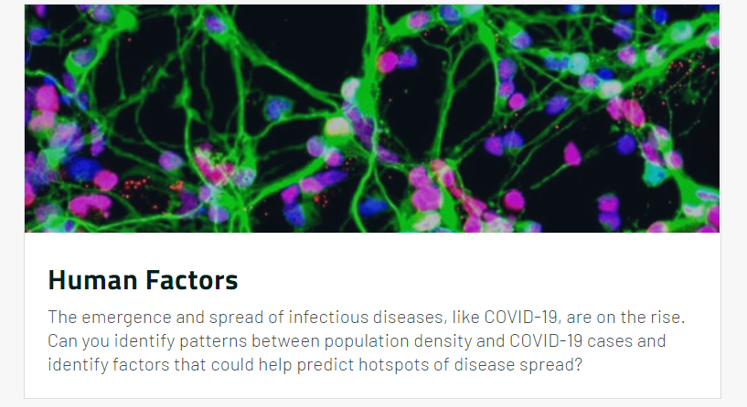
THE CHALLENGE

Slide 3
THE PROBLEM
UNEMPLOYMENT
Increased From 55% to 62%
More than 80 Millions of Students in Latin America and Caribbean Lost their Schools, and their Nourishment.
EDUCATION
Many Countries invest less than 7% on Health.
PUBLIC HEALTH SERVICES
In this year, at least 10 Millions will be pushed to Poverty.
POVERTY

Slide 4
OUR SOLUTION
PANDEMIC
ECONOMY CRISIS
You can simply impress your audience and add a unique zing and appeal to your Presentations. I hope and I believe that this Template will your Time, Money and Reputation.
Simple Portfolio
Modern PowerPoint Presentation
Portfolio Presentation
Presentation
Portfolio Presentation
Get a modern PowerPoint Presentation that is beautifully designed.
Simple Portfolio

Slide 5
FUTURE OF THE PROJECT
01
02
IMPLEMENT
EXPAND
Develop the algorithm in Latin America and Caribbean using the Datasets from the Space Agencies.
Improve the Dataset for more Regions in our Planet.

Slide 6







CREW MEMBERS
Mechatronics Engineering Students

Slide 7
ANALYTICS COVID
ATTACKING PANDEMICS WITH DATA

